Slide 1
REAL-TIME ACTIVE VISUAL TRACKING SYSTEM
Presentation By:
PATI AISHWARYA SRI (17WJ1A05N0)

Slide 2
ABSTRACT
The paper describes implementation of a real-time visual tracking system equipped with an active camera. The system is intended for indoor human motion tracking. Real-time tracking is achieved using simple and fast motion detection procedures based on frame differencing and camera motion compensation. Results of on-line person tracking are presented. Based on preliminary results of object detection in each image which may have missing and/or false detection, the multiple object tracking method keeps a graph structure where it maintains multiple hypothesis about the number and the trajectories of the object in the video. The image information drives the process of extending and pruning the graph, and determines the best hypothesis to explain the video. While the image-hued object detection makes a local decision, the tracking process confirm and validates the detection through time, therefore, it can be regarded as temporal detection which makes a global decision across time. The multiple object tracking method gives feedbacks which are predictions of object locations to the object detection module. Therefore, the method integrates object detection and trucking tightly. The most possible hypothesis provides the multiple object tracking result. The experimental results are presented.

Slide 3
Existing System
Multiple object tracking bas been a challenging research topic in computer vision.
It has to deal with the difficulties existing in single object tracking, such as changing appearances, non-rigid motion; dynamic illumination and occlusion, as well as the problems related to multiple object tracking including inter-object occlusion, multi-object concision.
There has been much work on multiple object visual tracking. They use a sampling algorithm for tracking fixed number of objects. Tao et al. [2] present an efficient hierarchical algorithm to track multiple people.

Slide 4
Proposed System
The tracking algorithm accepts the probabilities of preliminary object detection and keeps multiple hypotheses of object trajectories in a graph structure.
Each hypothesis consists of the number of objects and their trajectories.
The first step in tracking is to extend the graph to include the most recent object detection results, that is, to generate multiple hypotheses about the trajectories.

Slide 5
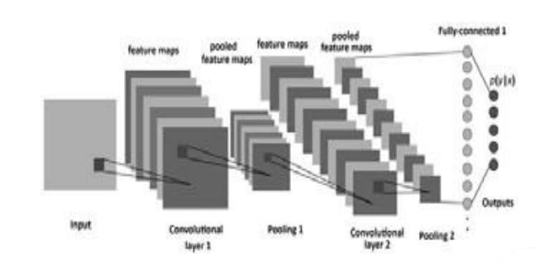
System Architecture

Slide 6
System Architecture
A system architecture is the conceptual model that defines the structure, behavior, and more views of a system.
An architecture description is a formal description and representation of a system, organized in a way that supports reasoning about the structures and behaviors of the system.

Slide 7
Modules
1. Input Images
2. Pre Processing
3. Segmentation
4. Classification

Slide 8
1.Input Images
Firstly we take an images for detecting the objects whose presented on the images at the anytime .
Then the image was in the forms of digital image.

Slide 9
2.Pre Processing
Pre-processing is a common name for operations with images at the lowest level of abstraction both input and output are intensity images.
These iconic images are of the same kind as the original data captured by the sensor, with an intensity image usually represented by a matrix of image function values (brightness).
The aim of pre-processing is an improvement of the image data that suppresses unwilling distortions or enhances some image features important for further processing, although geometric transformations of images (e.g. rotation, scaling, and translation) are also classified among pre-processing methods. Since here similar techniques are used.

Slide 10
3.Segmentation
We can divide or partition the image into various parts called segments.
It’s not a great idea to process the entire image at the same time as there will be regions in the image which do not contain any information.
By dividing the image into segments, we can make use of the important segments for processing the image.
That, in a nutshell, is how image segmentation works.

Slide 11
4.Classification
COCO is implemented to classify the different objects by training on these examples.
Different network configurations are experimented with to optimize the results of objects on the input images.
So the out will be display in model based detection.

Slide 12
Algorithm
Multi-modal self-paced learning for detection (MSPLD).
MSPLD that uses only a few bounding box labels per category by consistently implementing iterations between detector amelioration and reliable sample selection.
To enhance its detector learning capability with the scarcity of annotation, MSPLD embeds multiple detection models in its learning scheme.

Slide 13
Design Engineering
Design Engineering deals with the various UML [Unified Modelling language] diagrams for the implementation of project.
Design is a meaningful engineering representation of a thing that is to be built.
Software design is a process through which the requirements are translated into representation of the software.
Design is the place where quality is rendered in software engineering. Design is the means to accurately translate customer requirements into finished product.

Slide 14
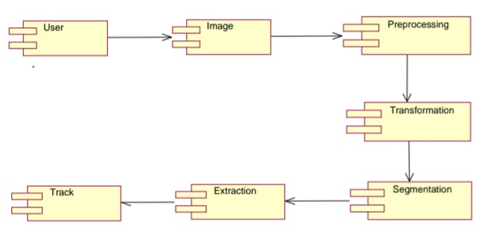
Component Diagram
A component diagram, also known as UML component diagram, describes the organization and wiring of the physical components in a system.
It double-check that every aspect of the system's required functions is covered by planned development.

Slide 15
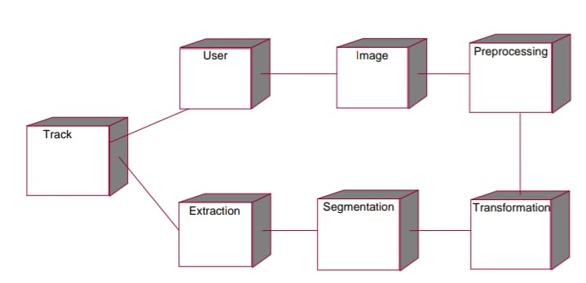
Deployment Diagram
A deployment diagram shows the execution architecture of a system, including nodes such as hardware or software execution environments, and the middleware connecting them.
Deployment diagrams are typically used to visualize the physical hardware and software of a system.

Slide 16
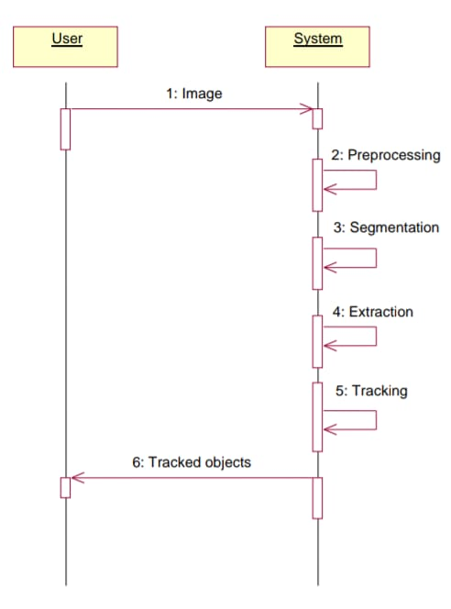
Sequence Diagram
A sequence diagram simply depicts interaction between objects in a sequential order i.e. the order in which these interactions take place.
Sequence diagrams describe how and in what order the objects in a system function.

Slide 17
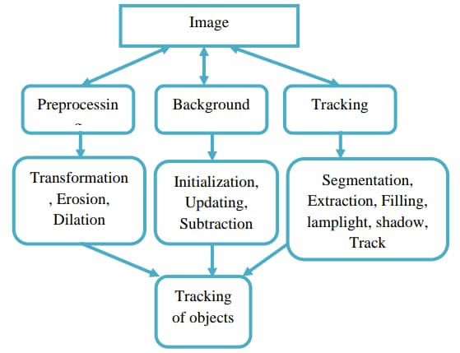
Data Flow Diagram
A data flow diagram (DFD) is a graphical representation of the "flow" of data through an information system, modeling its process aspects.
A DFD shows what kinds of data will be input to and output from the system

Slide 18
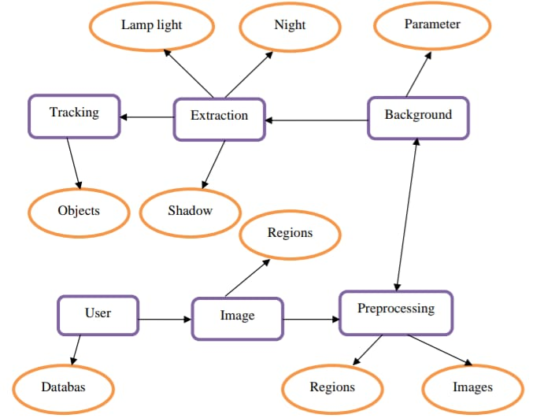
Entity Relationship Diagram
Entity-Relationship Model (ERM) is an abstract and conceptual representation of data.
Entity-relationship modeling is a database modeling method, used to produce a type of conceptual schema or semantic data model of a system, often a relational database.

Slide 19
Conclusion
The tracking module provides feedbacks to the object detection module to improve the local detection performance.
According to the trajectories in the top hypothesis, the multiple object tracking module predicts the most likely locations to detect objects.
This interaction tightly integrates the object detection and tracking, and makes both of them more reliable.

Slide 20
Future Enhancement
An image based likelihood is then computed to give a probability to each hypothesis.
This computation is based on the object detection probability, appearance similarity, trajectory smoothness and image foreground coverage and compactness.
The probabilities are calculated based on a sequence of images, therefore, they are temporally global representations of hypotheses likelihood.
The hypotheses are ranked by their probabilities and the unlikely hypotheses are pruned from the graph in the hypothesesmanagement step.

